Slide 1
E-Voting System
MD.Saiful Islam(2132105642)
Ariful Alam Abir(2122236642)
Apurba Krishna Dash(2222691642)

Slide 2
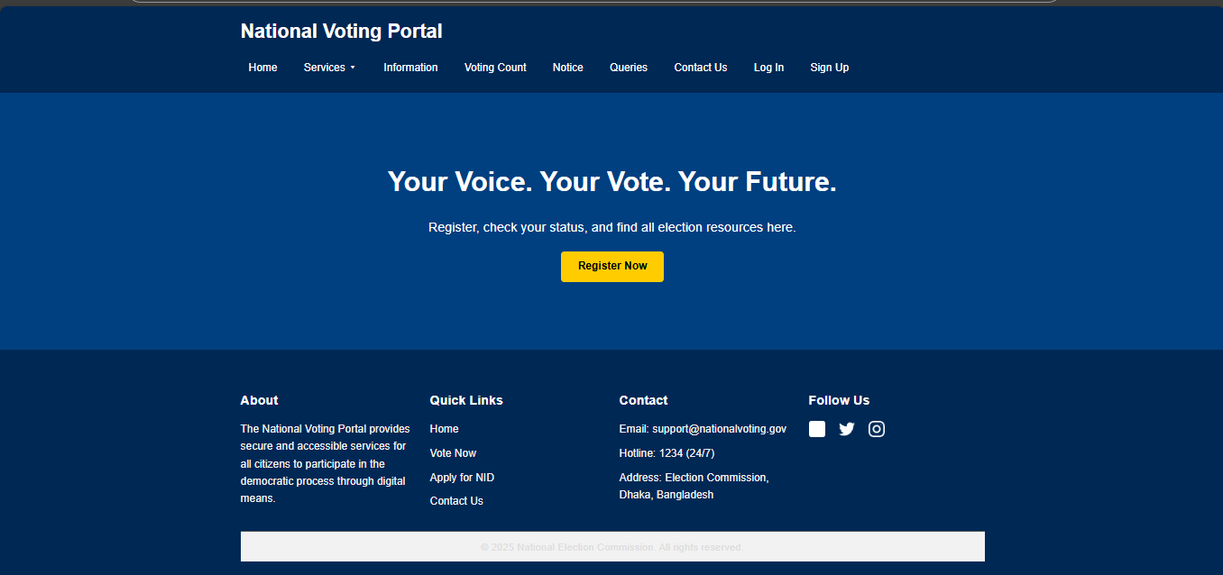
Home Page :

Slide 3
Home page :
This is our home page for this project . In home page there are 9 toolbar. They are:
Services
Information
Voting count
Notice
Queries
Contact us
Log in
Sign up
Let’s talk about all toolbars in details .

Slide 4
Services:
In services there are 6 portal available . They are :
Birth certificate Apply
Birth certificate Log in/Download
Birth certificate correction
NID card Apply
NID card Correction
NID card Download
No we will discuss about Birth certificate Apply first :

Slide 5
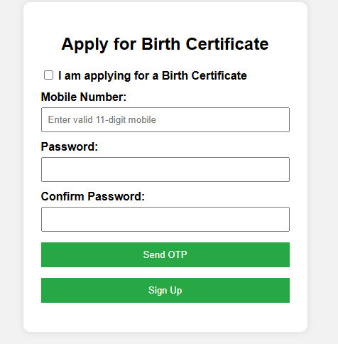
Birth certificate apply
If we enter the birth certificate apply portal firstly this interface will came up . Here user have to give their mobile number and password and an otp will generate and have to put the correct otp .And this will take to next page . At the same time data will store in our database . A sample stored data is showed in picture .

Slide 6
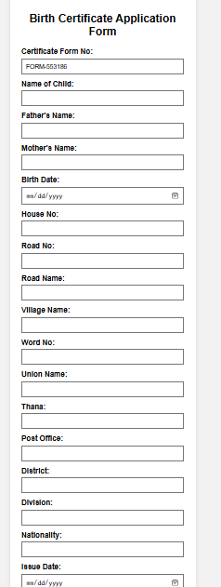
Birth certificate application form :
Ater sing up user will find this page . And here user needs to fill up all information table and his/her data will stored in our data base . A Sample data table showed in picture .

Slide 7
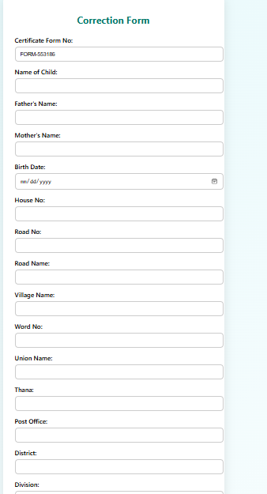
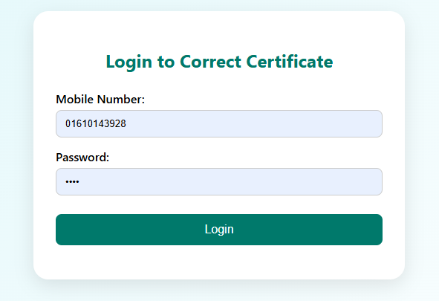
Birth certificate Correction :
For the correction of birth certificate user needs the same mobile number and the password to log in and can correct his birth certificate . Here is the correction page ---→

Slide 8
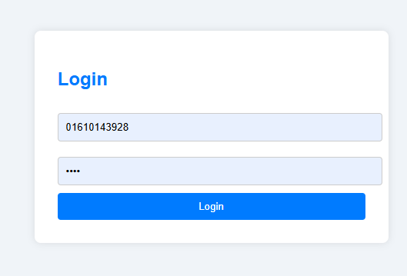
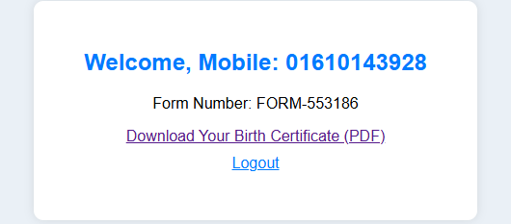
Birth Certificate Download :
For birth certificate download then just simply enter the portal and need to put registered information .And this will take them in pdf download page →

Slide 9
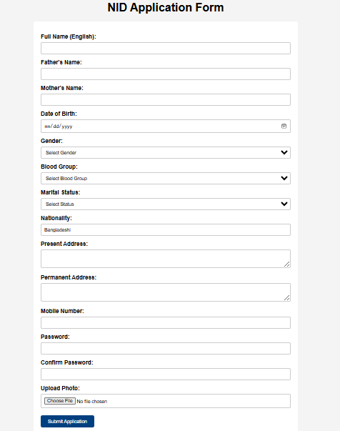
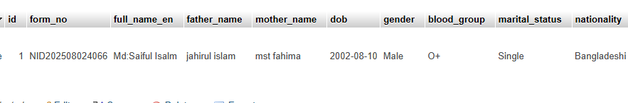
NID Card apply :
This is the nid card apply from . From where user can apply for his nid. The same stored data is showed in picture below :

Slide 10
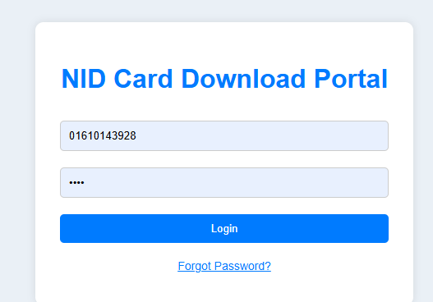
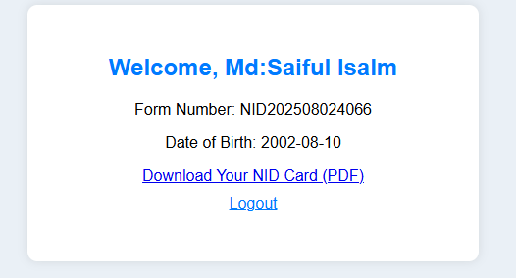
NID card Download :
By entering with valid mobile number and password the page will take user into the page where a ready pad version of his NID is ready -→ From where he can download it .

Slide 11
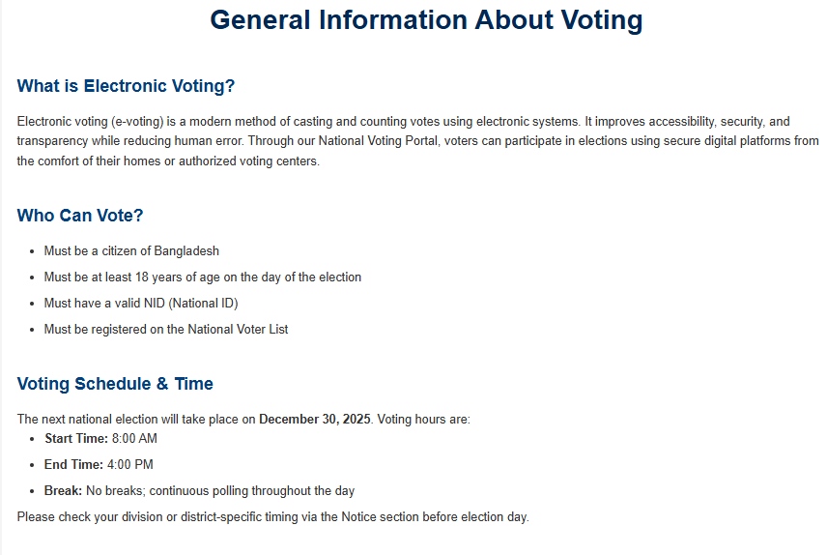
Information Toolbar
This toolbar will give the information about voting ,how to register for vote , how to register for nid,birth certificate , or download etc .

Slide 12
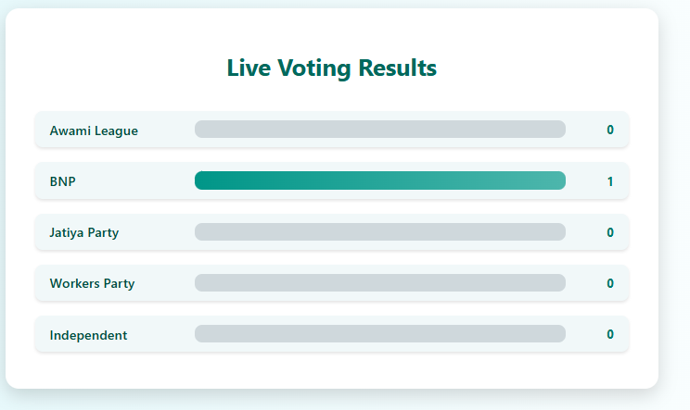
Voting count
The vote user will cast store in our database and also it will show the live counting of voting . As we can see 1 vote is casted for BNP

Slide 13
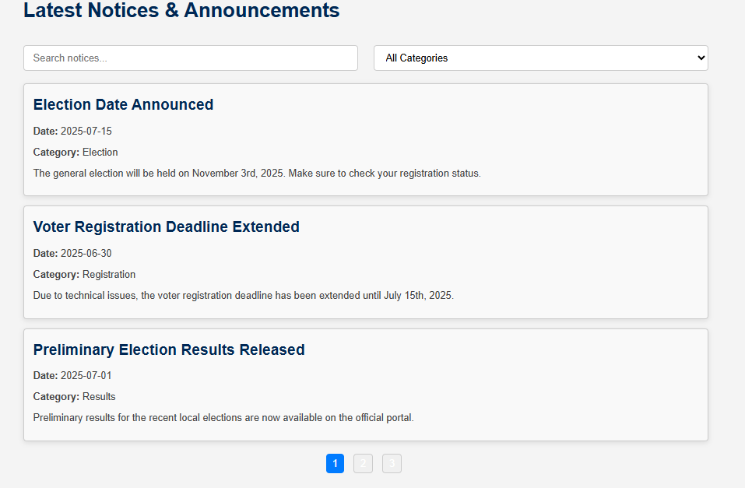
Notice
All the notices given by EC will show here . Voters can see the important dates from this toolbar .

Slide 14
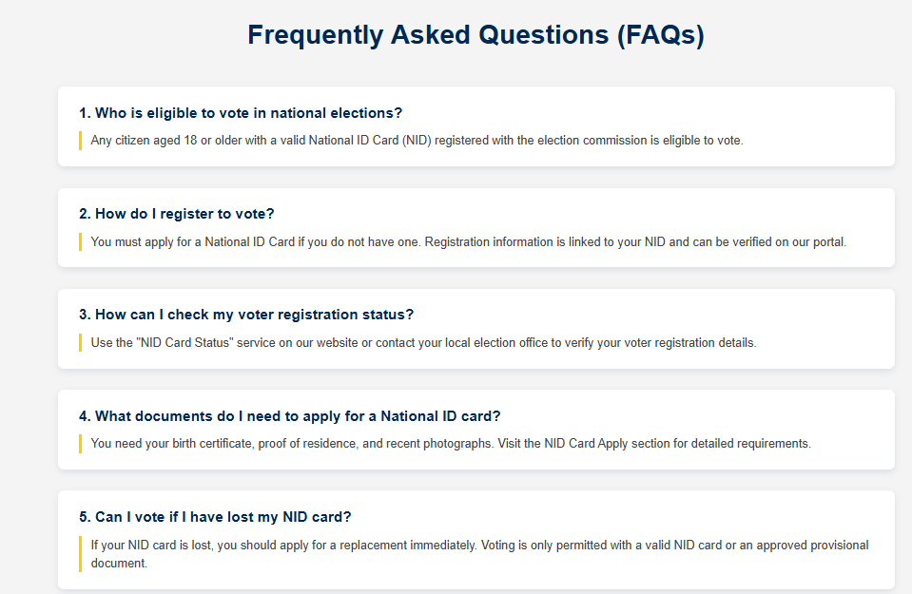
Queries
The question usually an user can asked is given in this section and the will get answer of it .

Slide 15
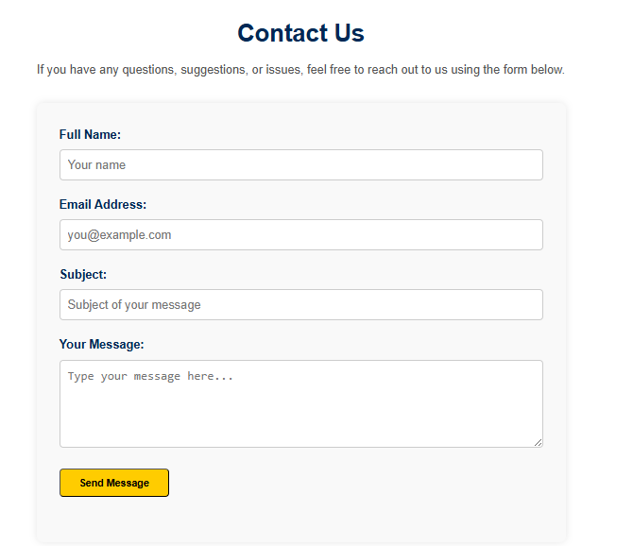
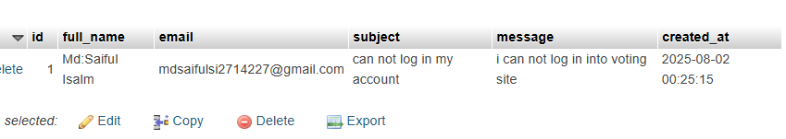
Contact US
An user can contact us through this website by this toolbar . And his asked question or problems will be stored in our database . For example :

Slide 16
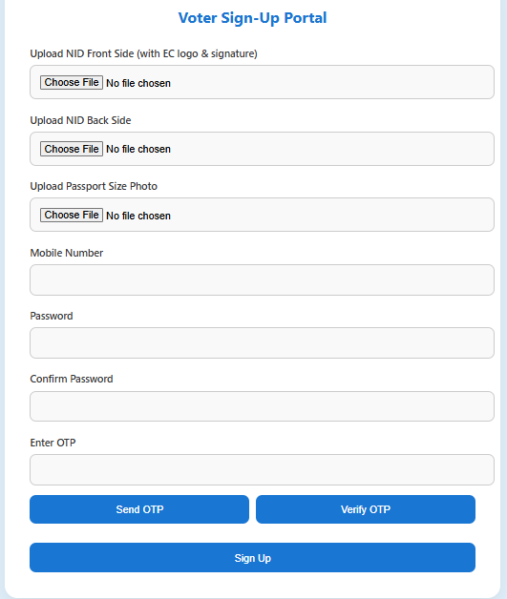
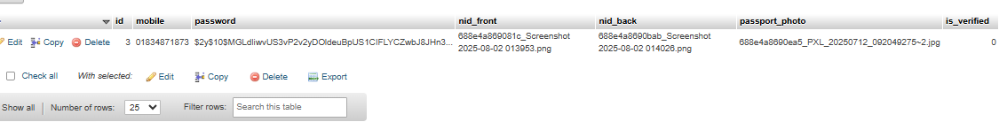
Voter Sign Up
Voter can sign up here to give vote . Without registering no voter can log in . And the data will save in our database . And the pictures will save in our main database folder .

Slide 17
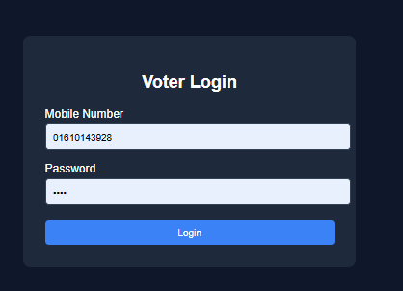
Voter Log in
After sign up voter will log in with valid mobile number and password . It will take him/her into voting dashboard .

Slide 18
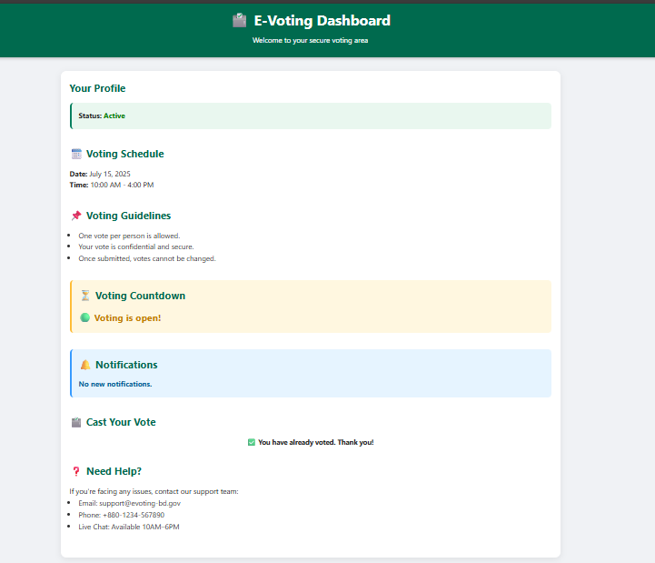
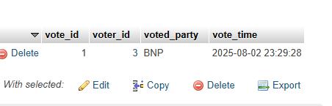
Voting Dashboard
This is the voting dashboard as the user voted for once we can not vote again . After voting the data will store in database .→

Slide 19
Thank you for Having with Us . Any Question?

